Slide 1
Cartooning an Image using OpenCV in MACHINE LEARNING
A project to transform images into cartoon-like visuals through sequential image processing techniques.
SUBMITTED BY
K.SINDHUJA
23202009
Under Guidance:
Dr. P.S. Latha Kalyampudi, Assistant Professor
Department of Computer Science
Central Tribal University of Andhra Pradesh

Slide 2
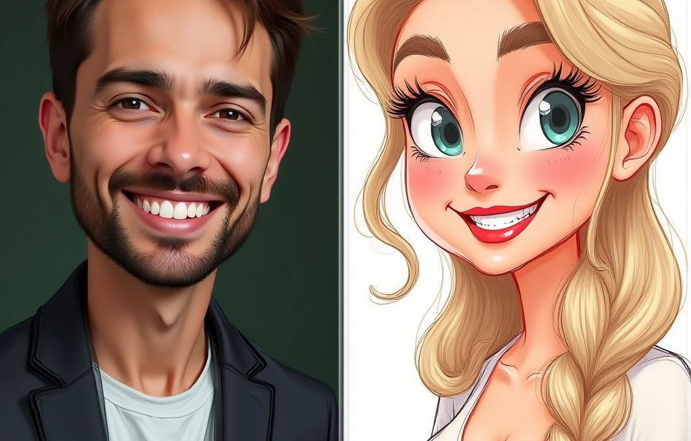
Introduction
This project focuses on creating a Python-based system that converts input images into cartoon-style images.
It uses OpenCV to apply multiple image processing steps that enhance visual features and simplify details.

Slide 3
Provides an automated way to create artistic cartoon images from photos.
Importance of the Project
Simplifies Complexity, Reduces noise while preserving essential details
Useful in entertainment, graphic design, and educational tools.

Slide 4
Manual cartooning of images is time-consuming and requires artistic skills.
Problem Statement
Need for an efficient automated method to produce cartoon effects on images.

Slide 5
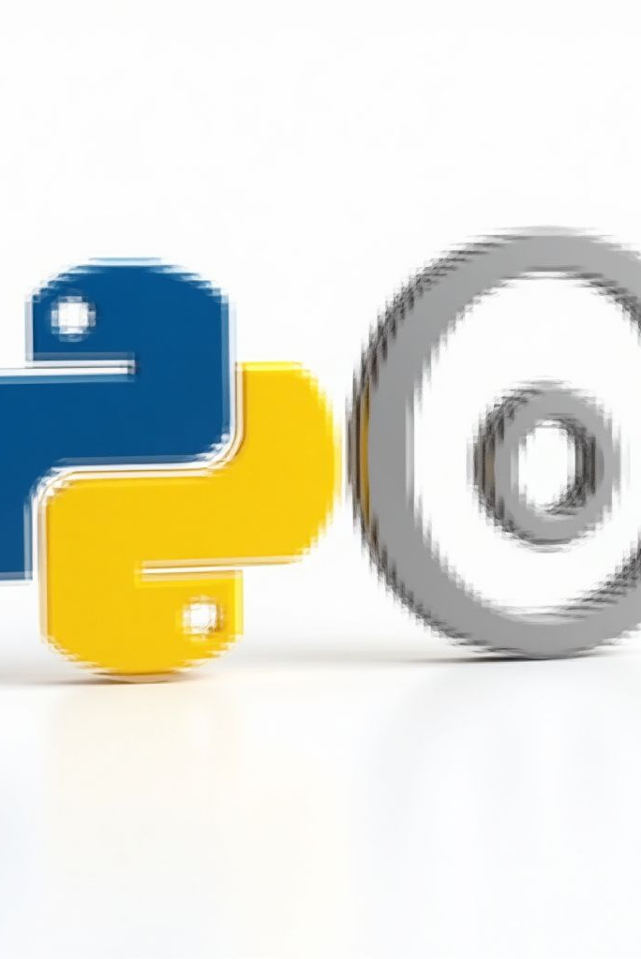
Technologies Used
Python programming language for implementation.
OpenCV library for image processing tasks.

Slide 6
Develop a system to convert images into cartoon-like versions automatically.
Objectives
Apply sequential image processing techniques to enhance edges and colors.

Slide 7
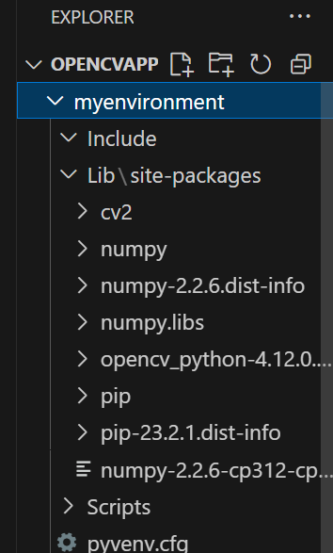
Feasibility Study
Technically feasible using OpenCV’s image processing capabilities.
Cost-effective as it uses open-source tools and requires minimal hardware.

Slide 8
METHODOLOGY
Convert image to grayscale to simplify intensity variations.
Methodology
1
Reduce noise using median blur to preserve edges..
2
Detect edges with adaptive thresholding.
3
Smooth colors using bilateral filtering.
4

Slide 9
MODULE OVERVIEW
Image Preprocessing: Grayscale conversion and noise reduction.
Color Smoothing: Bilateral filtering on the original image.
2
4
1
3
Edge Detection: Adaptive thresholding to find contours.
Image Combination: Overlaying edges on smoothed colors.

Slide 10
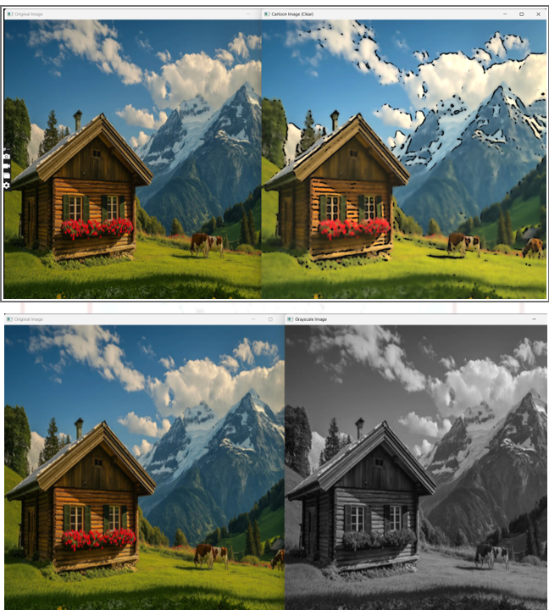
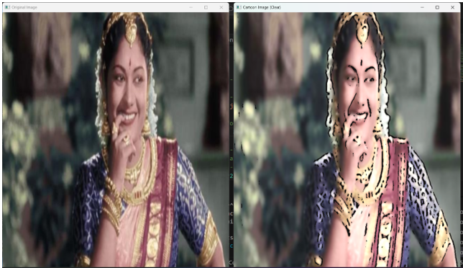
01
OUTPUT

Slide 11
Conclusion
The project successfully creates cartoon-like images by combining multiple image processing techniques.
It offers a practical and automated solution for artistic image transformation using Python and OpenCV.

Slide 12
Thank you for your time
and attention

